Slide 1
DIRECTION LENS
Supervisor: Mr. Nguyễn Văn Sang
Phan Thị Loan 01869
Hồ Anh Tú 01850
Bùi Như Tú 01872
Đào Xuân Mão 00257
Nguyễn Mạnh Cầm 01747

Slide 2
DIRECTION LENS
The Idea
System purpose/ objective
Requirements
Functionalities
Problem Definition

Slide 3

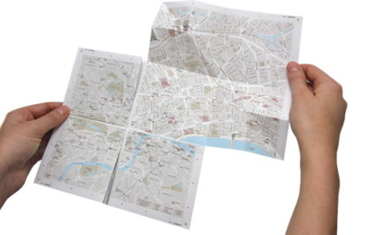
DIRECTION LENS
Problem Definition
Are you traveling? Are you in a new or strange city? You don’t know how to way ? And you want to find some places like hotel, restaurant, park,…?
So, how can you move and find places fast and easy??
May be you can using paper map
Difficult to find way
Some locations not found
Spend a lots time
BUT
No navigation, no direction
Map is not auto update

Slide 4
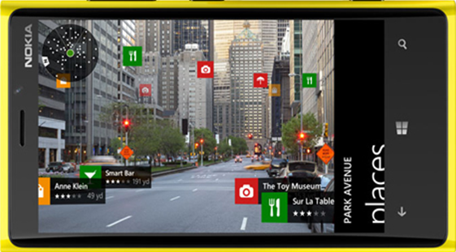
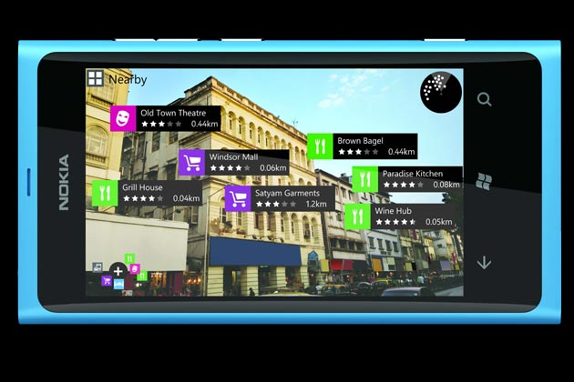
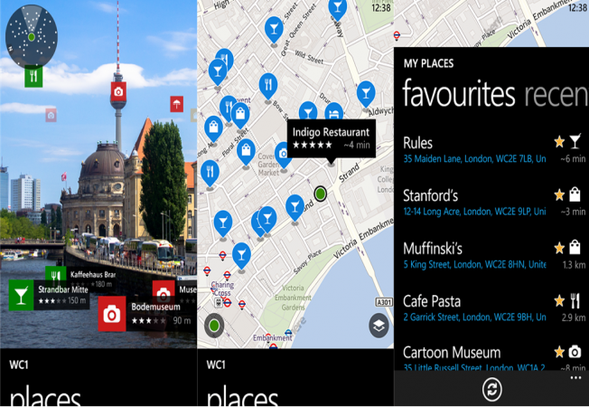
DIRECTION LENS
Problem Definition
Currently, window phone bring out product Nokia City Lens which has features navigation, search and directions.

Slide 5
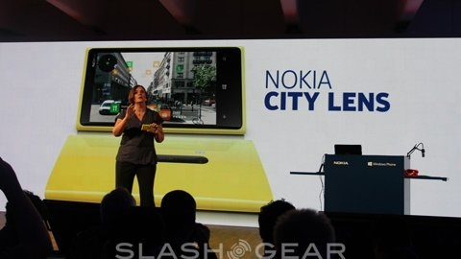
DIRECTION LENS
Problem Definition
Nokia City Lens is so good but :
Not integrated database.
No personalize for user.
Not extensively used on other maps API.
limitations in updating database.
No exchange language

Slide 6




DIRECTION LENS
The Idea
DLs Team will make :
application in positing and direction with AR technology and gyroscope device.
a better software and drive comfortable, easier, and convenient for user, first is Vietnamese.
to solve problem, improve some features to be friendly and interactive.

Slide 7


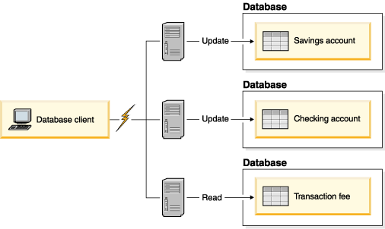

DIRECTION LENS
The Idea
Direction Lens is different from other products at some features and they are mark highlights of DLs:
integrated database personalize for user easy update database exchange language

Slide 8
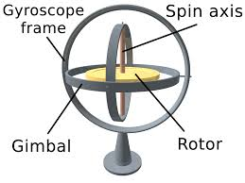



DIRECTION LENS
The Idea
The combination between
And
DLs will have two modules : mobile and web
On mobile for user on web for admin management
The combination between
And
DLs will have two modules : mobile and web
On mobile for user on web for admin management

Slide 9

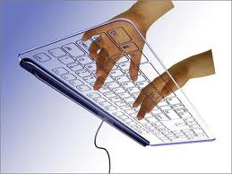
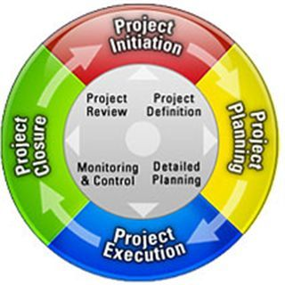

DIRECTION LENS
Objectives
To meet requirements from FPT University. Completing projects is necessary conditional for us to graduate.
Learning new technologies :AR technology, embedded mobile,
gyroscope, Android OS, Google Maps API,..
Learning control and manage project
development process

Slide 10





DIRECTION LENS
Objectives
Getting more experiences in teamwork, improve skills.
Making a project marked our own

Slide 11




DIRECTION LENS
Objectives
Completing project, be actual application, expanding in the future.

Slide 12
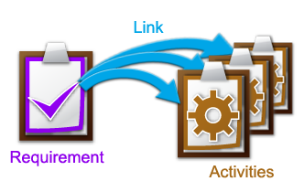
DIRECTION LENS
Functional Requirements
The system will be developed on both the mobile and web.
Functional requirements for mobile are used by guest and users have account. That means if user log in or not , they still do some normal tasks as view, get direction.

Slide 13
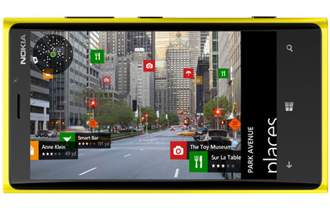
DIRECTION LENS
Functional Requirements
(Guest and user have account)
When the camera turned on, the system
would determine the location of the user
at that time through the GPS navigation systems.
Simultaneously, all places are in 5km radius
(fix default, can change this radius) will be
displayed on the screen for user see.

Slide 14
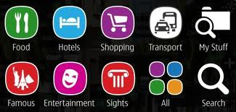
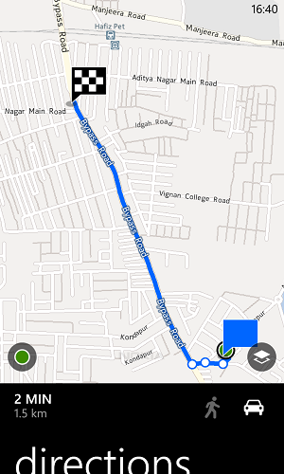
DIRECTION LENS
Functional Requirements
(Guest and user have account)
User can filter and searching location by category
(like: food, hospital, shopping, hotel, …)
User can choose a place then view information
of place or get direction to it.

Slide 15
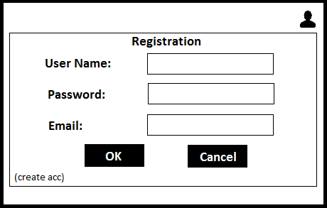
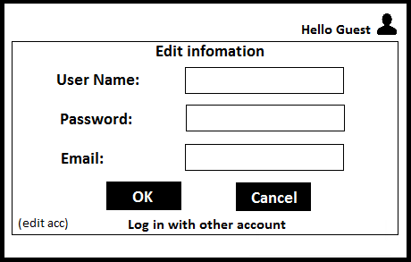
DIRECTION LENS
Functional Requirements
(Guest)
If user is guest, they can sign up
and then edit their information .

Slide 16
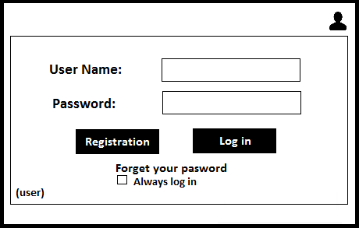
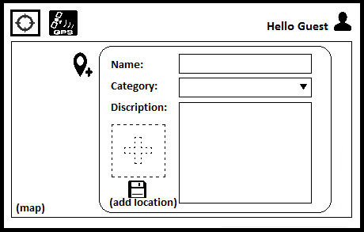
DIRECTION LENS
Functional Requirements
(User have account)
Users have account, they can log in system
and add new place or mark favorite places

Slide 17
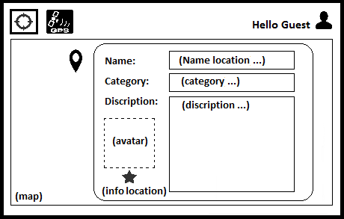
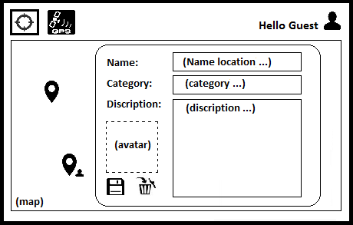
DIRECTION LENS
Functional Requirements
(User have account)
User can edit or delete places that they mark “MyPlaces”

Slide 18
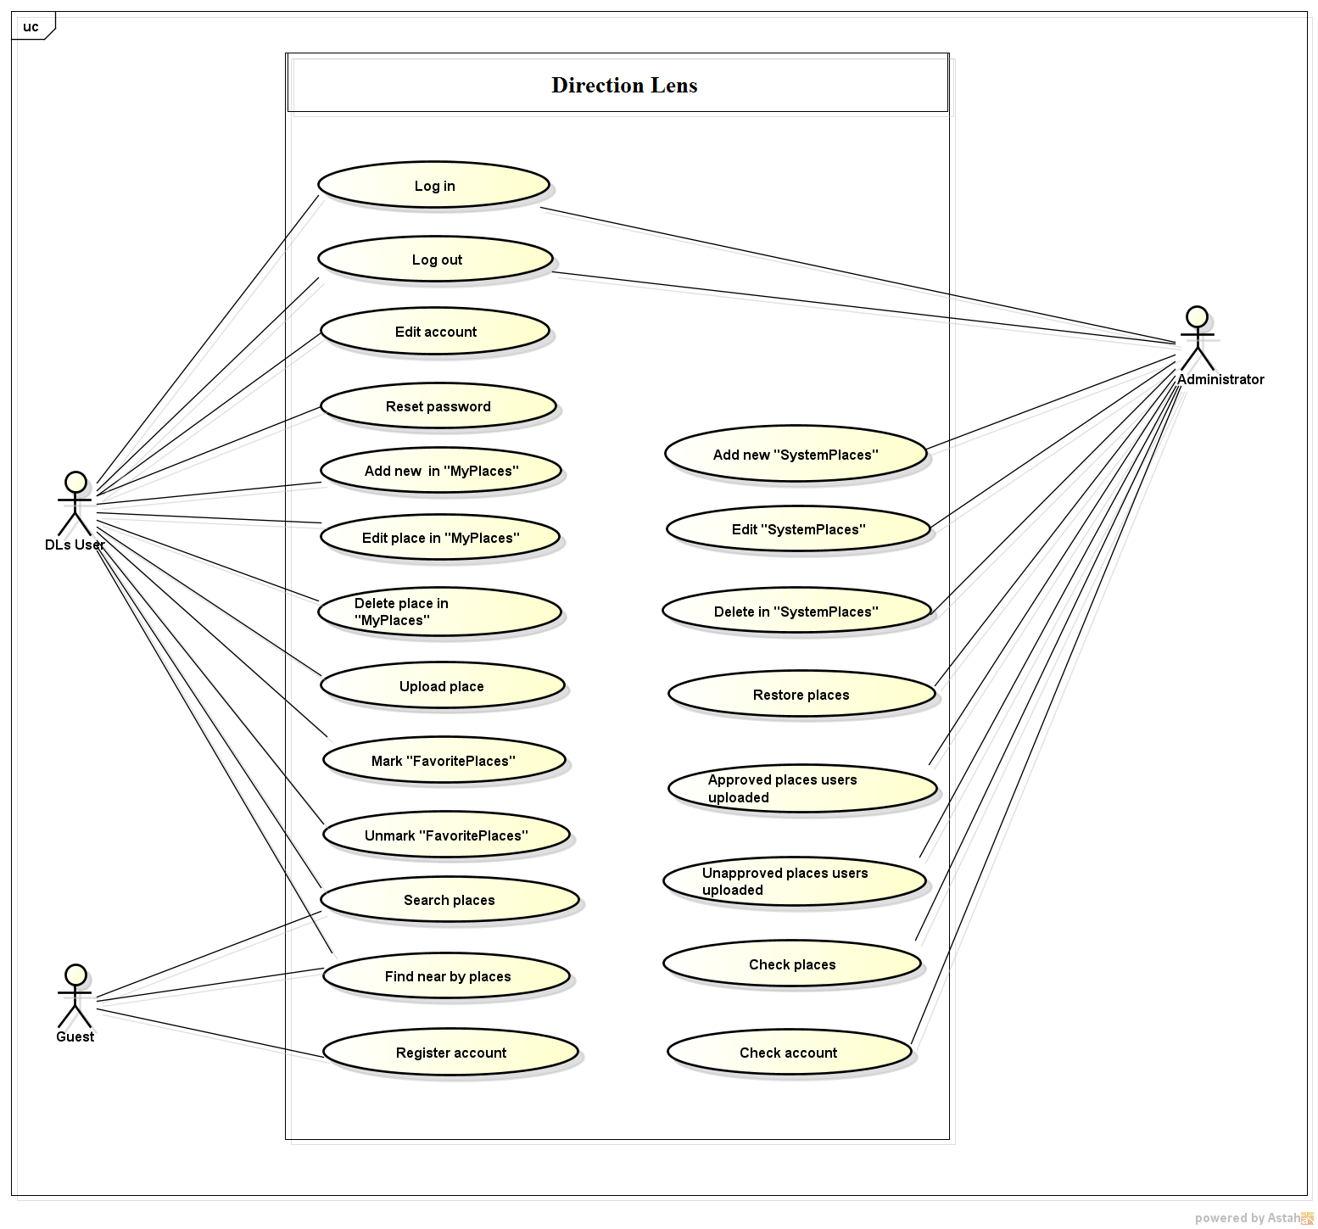
DIRECTION LENS
Use Cases Diagram

Slide 19
DIRECTION LENS
Functional Requirements
(Admin)
Functional requirements for web are used by admin only.
Management locations on Database: add new, edit, delete, and restore location.
Verify the authenticity of the location’s information that user added.

Slide 20
DIRECTION LENS
Functionalities
Function on android app ( for user)
GPS to identify location of device.
Register user.
Log in, change account.
Reset password.
Display locations around the fix default radius (estimate 5km)
Searching by category and radius
Display information of places
Give direction

Slide 21
DIRECTION LENS
Non- Functional Requirements
Performance: time to response, time of processing.
Availability: hours of operation and location of operations.
Maintainability: architectural standards, coding standards.
Usability: friendly, interactive.
Capacity and scalability: throughput, storage and growth requirements.

Slide 22
DIRECTION LENS
Functionalities
Add/remove places to “FavoritePlaces”
Add new place.
Edit information in “MyPlaces”
Delete places in “MyPlaces”

Slide 23
DIRECTION LENS
Functionalities
Add new places.
Edit information of places on system
Delete places
Restore places
Verify information user added.
Function on Web( for admin)

Slide 24


